Slide 1
Preliminary results on SE1 beamline
ATTOlab Users’ meeting
8/11/2017
Christina Alexandridi
LIDyL/ATTO
M. Turconi, L.Barreau, A. Borot , D. Platzer, B. Carré, P. Salières

Slide 2
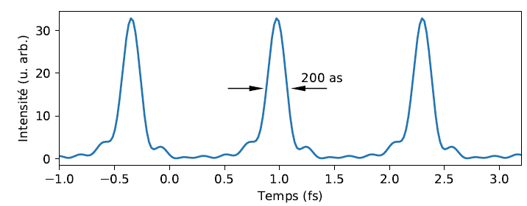
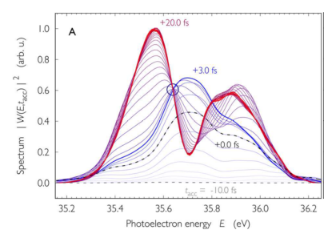
RABBIT technique
Coherent XUV+IR photoionization → EWP interferometry
E [eV]
$$S_{SB}∝cos⁡[{2ω}_{0}+{Δφ}_{attochirp}+Δφ_{atomic}]$$
Characterisation of the ionizing pulse train
$${IR}_{ω_{0}}$$
Photon energy [eV]
H37
H35
H33
21.56
Photoionization dynamics of the target atom
0
Harmonic comb
Delay XUV-IR [fs]
The ‘perfect’ RABBIT
:High contrast/ well defined 2ω oscillations
→temporal +spatial stability
V. Gruson et al., Science(2016)

Slide 3
The set up
800nm
25fs
~7.5mJ
Delay stage
BS 90:10
f=400mm
Attenuator
MBES
f=1140mm
Toroidal
f=2000mm
Al filter
Gas jet
Drilled mirror
Gas cell
Silica plate
MCP
Grating
phosphore
MCP
Phosphore

Slide 4
Astigmatism
@focus
@before focus
@after focus
y_axis[pixels]
x_axis[pixels]
y_axis[pixels]
x_axis[pixels]

Slide 5
Detection configuration
800nm
25fs
~7.5mJ
Delay stage
BS 90:10
f=400mm
Attenuator
MBES
f=1140mm
Toroidal
f=2000mm
Al filter
Gas jet
Drilled mirror
Gas cell
Silica plate
MCP
Grating
phosphore
MCP
Phosphore

Slide 6
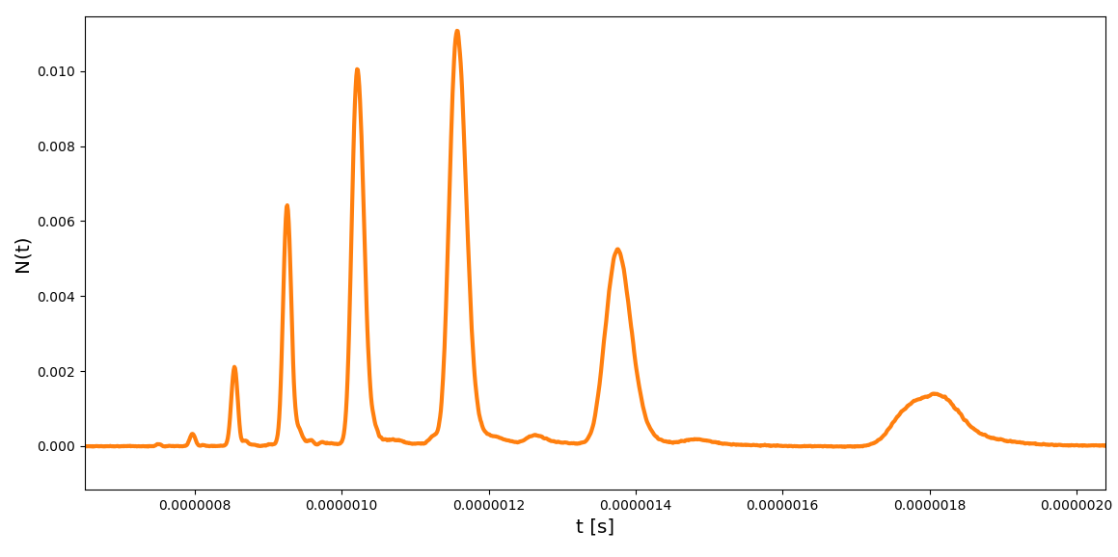
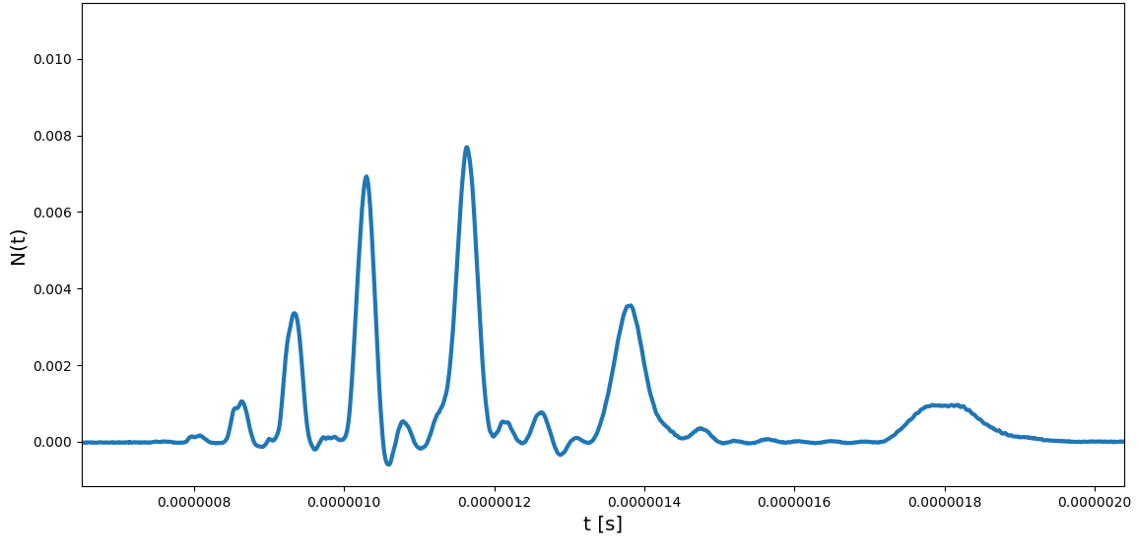
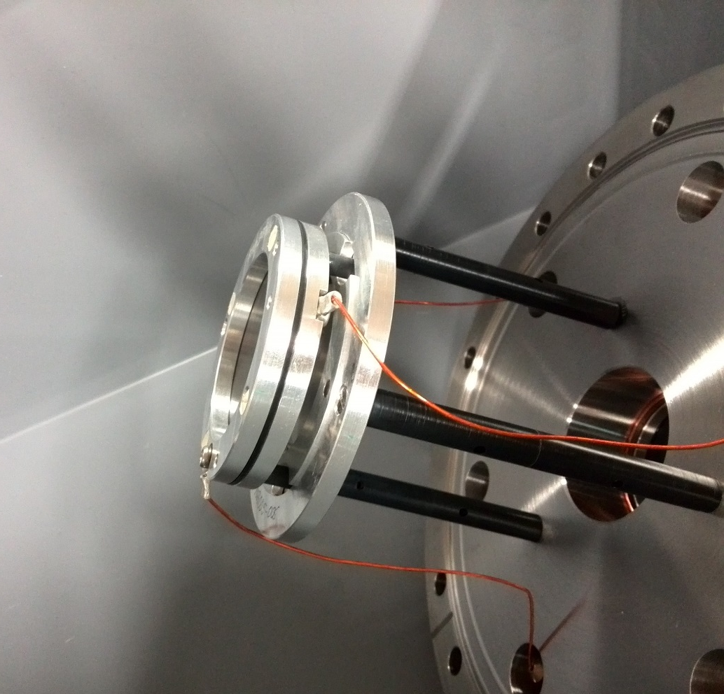
Photoelectron detection configuration
Detector: MCP + Phosphor
Detector: MCP + Phosphor
MCP front
MCP back
Phosphor
→Reading from the back MCP, connected to the decoupling box
→Reading from the Phosphor, connected to the decoupling box and added a bandpass filter to the MCP back

Slide 7
Spatial Stability
800nm
25fs
~7.5mJ
Delay stage
BS 90:10
f=400mm
Attenuator
MBES
f=1140mm
Toroidal
f=2000mm
Al filter
Drilled mirror
Gas jet
Gas cell
Silica plate
MCP
Grating
phosphore
MCP
Phosphore

Slide 8
Spatial Stability
Initial dressing arm configuration
Delay stage
BS 90:10
Attenuator
f=1140mm
→ Uneven number of reflectrions between the generation and dressing path

Slide 9
Spatial Stability
Final dressing arm configuration
Delay stage
BS 90:10
f=400mm
Attenuator
f=1140mm

Slide 10
Position of dressing lens
Delay stage
BS 90:10
f=1140mm
f=400mm
Attenuator
Before
After
FFT amplitude
FFT amplitude
FFT amplitude
ω/ω₀
ω/ω₀
ω/ω₀

Slide 11
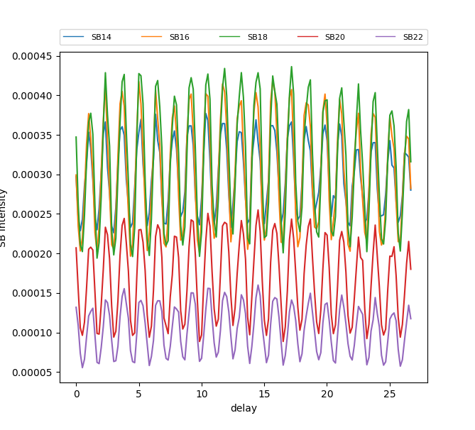
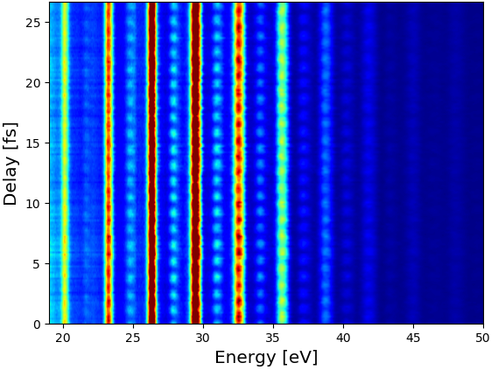
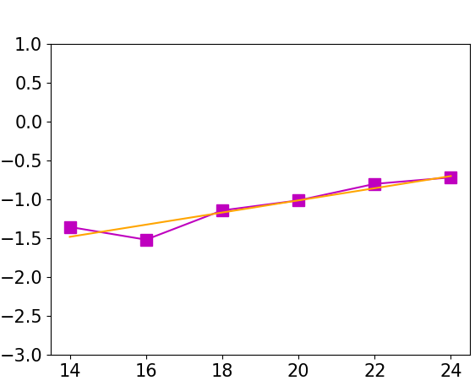
The final RABBIT
SB Intensity
Temporal and spatial stability
Delay [fs]
→ Delay of a couple of fs over 3 hours
2ω oscillations
Argon
FFT amplitude
Max Contrast = 0.52
Phase [rad]
Attochirp=15.6 as
ω₀
SB order

Slide 12
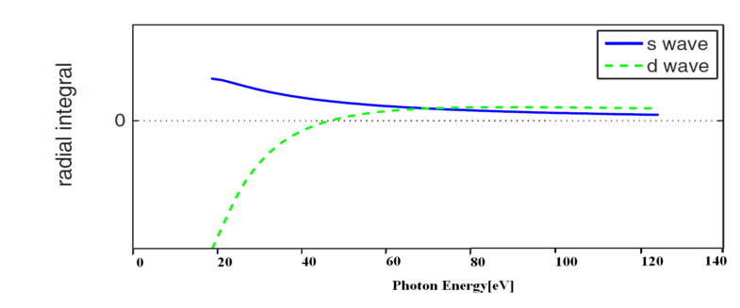
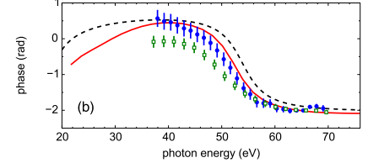
Cooper Minimum in Argon
What is it?
Motivation:
→ No need of OPA
(Chirla thesis,2014)
→ Comparison with HHG spectroscopy
(Schoun et al., PRL,2014)

Slide 13
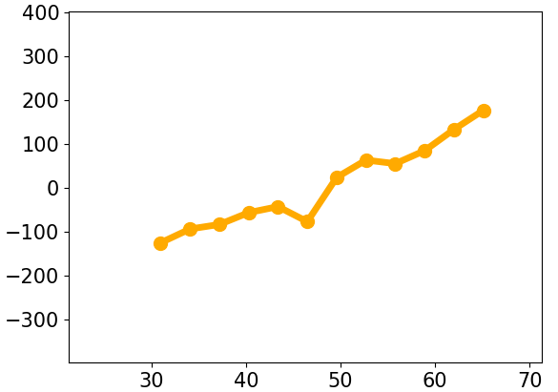
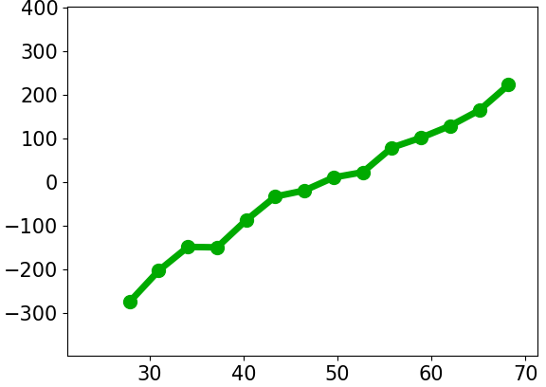
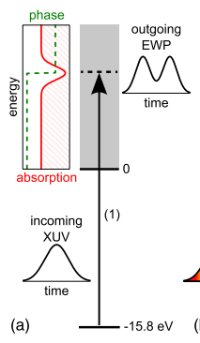
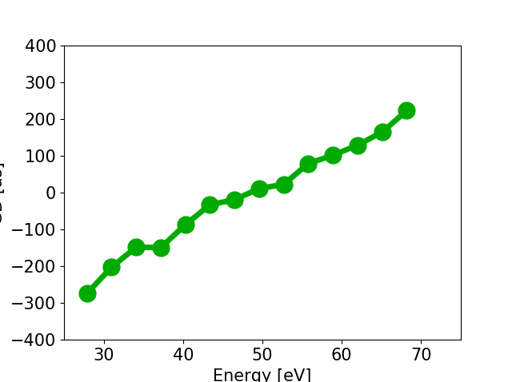
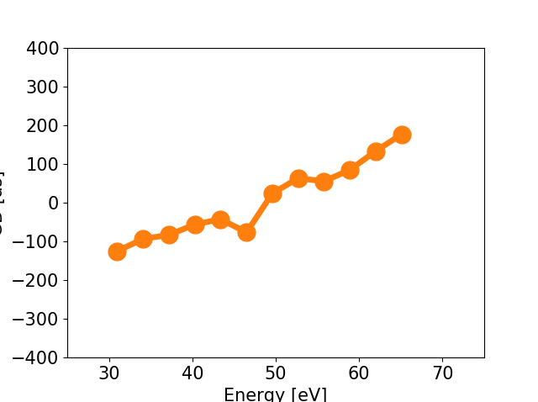
Cooper Minimum in Argon
Otan sugkrineis me schoun tsekare gt stis diaforetika lamda einai kounimeno to deep
Photoionization process
CM
Generation→ Neon
Detection → Argon
group delay (as)
Neon-Neon
Neon-Argon
~46.5 eV
(Schoun et al., PRL,2014)
photon energy (eV)
CM

Slide 14
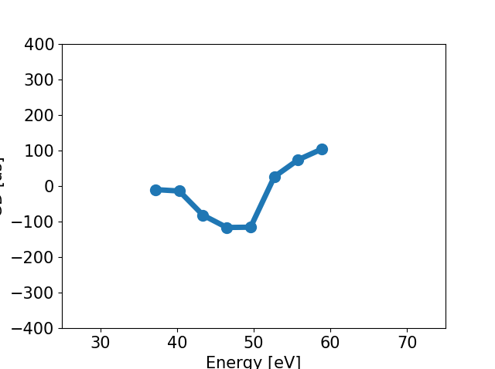
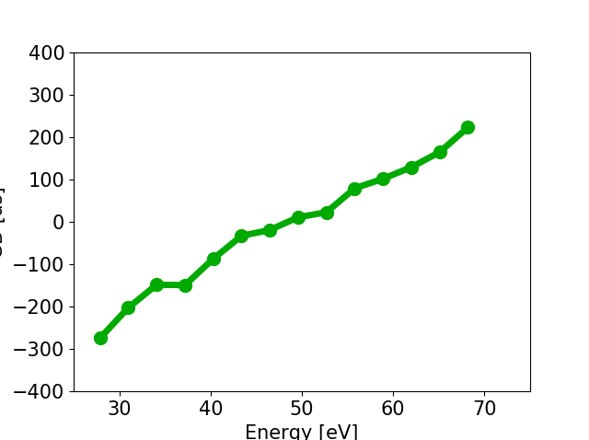
Cooper Minimum in Argon
Recombination process
CM
Generation→ Argon
Detection →Neon
Neon-Neon
group delay (as)
Argon-Neon
~49.6 eV
(Schoun et al., PRL,2014)
photon energy (eV)
CM

Slide 15
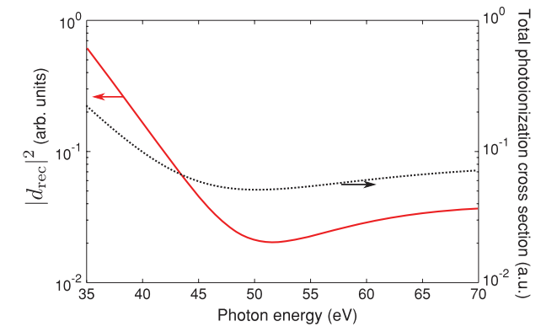
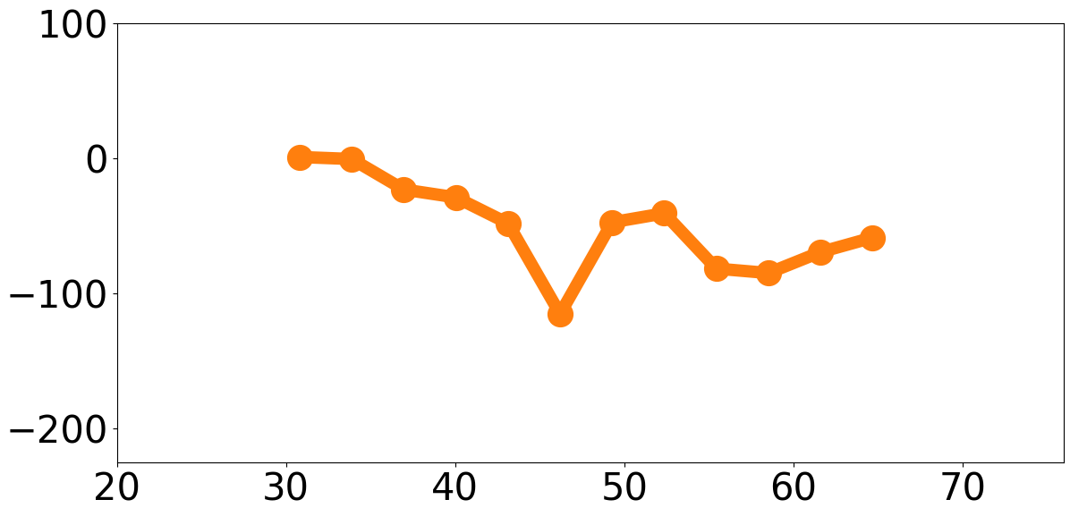
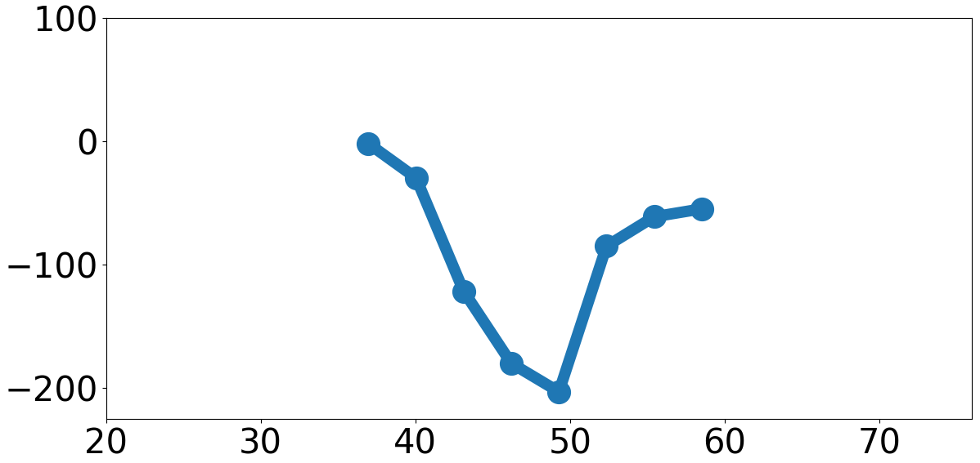
Cooper Minimum in Argon
(Higuet et al., PRA,2011)
photoionization
recombination
Photoionization
~46.5 eV
~48 eV
Recombination
group delay (as)
~51.6 eV
~49.6 eV
photon energy (eV)
photon energy (eV)
Recombination
: Coherent sum of p→s +p→d
Energy shift
Less contrasted deep
1.
Photoionization
: Incoherent sum of p→s +p→d
2.
Shape of the recolliding EWP

Slide 16
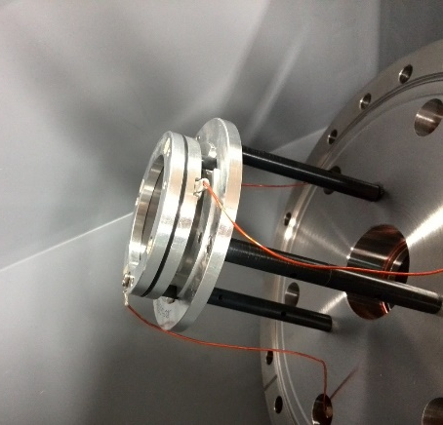
Conclusions
Astigmatism of the initial beam
Cooper minimum in Argon:
Photoionization
Detection configuration
group delay (as)
photon energy (eV)
Spatial stability
Recombination
Position of the dressing beam lens
group delay (as)
ω/ω₀
photon energy (eV)

Slide 17
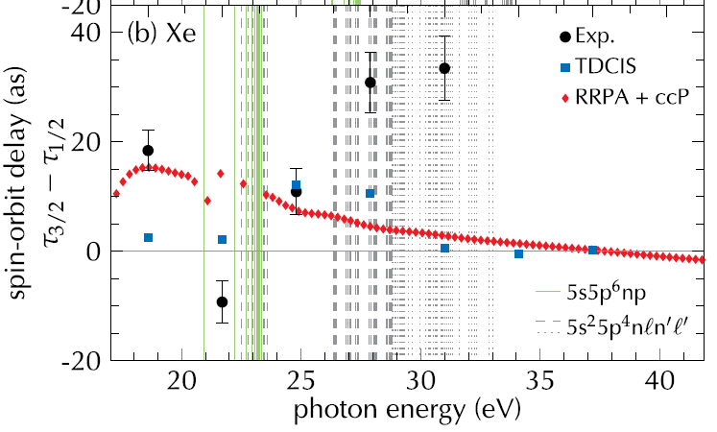
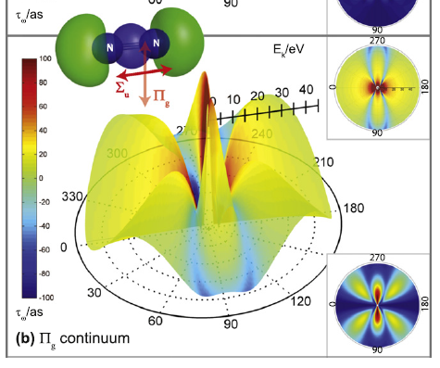
Outlook
Spin-Orbit splitting in Xenon ~ 1.3eV
Scattering phase around Hopfield resonance
In N2
OPA → better sampling
→ tunability around the resonances
S. Haessler et al., PRA 80, 011404 (2009)
J. Caillat et al., PRL 106, 093002 (2011)
Study of the PI delays in laser-aligned molecules
I. Jordan et al., PRA 95, 013404 (2017)
P. Hockett et al., JPB 49, 095602 (2016)

Slide 18
Merci pour votre attention !

